Slide 1

A Theoretical Perspective of
Tax Complexity
Indexes
MIRDEC 2020
International Academic Conference
Multidisciplinary Issues and Contemporary Discussions in Social Science
Tamer Budak & Serkan Benk
Turkey
Notes:
“Hello everybody! I am very happy to be in front of you via internet. My name is Tamer Budak. I am a professor in tax law at University of Alanya, Turkey, This paper was prepared by Serkan Benk and me. I am going to present this paper titled A Theoretical Perspective of Tax Complexity Indexes …..”

Slide 2
Overview
Introduction
Definition of tax complexity
Initiatives for measuring complexity
Results

Slide 3
1. Introduction
Australia, NZ and UK have attempted to simplify their tax systems but limited success.
Important to be able to measure complexity and make comparisons

Slide 4
2. What is tax complexity?
Due to many reason, countries’ tax systems are becoming more complex for many years.
Tax complexity is an important issue for countries.
It is not possible to make all tax system the simplest.
Because there is an inverse relationship between tax equity, social state, equality and simplicity.
There are lots of reasons why tax systems are complex.
One of the aims for tax reforms aims to decrease tax complexities and to increase the level of tax compliance.

Slide 5
Nonetheless, there are some initiatives related to simplification of tax system which are of importance.
Some countries such as Australıa, New Zealand (NZ) and the UK have attempted to simplify their complex tax system.
However all pionering countries’ tax systems are still complex.
It is in the light of the fact that the Office of Tax Simplification has created an index that significantly contribute in this field in the UK.

Slide 6
Defining ‘complexity’ is actually not easy.
Most writers avoid defining the tax complexity but instead they have listed and categorised some factors that contribute to complexity.

Slide 7
Often describe characteristics or dimensions, e.g.
Slemrod, four main dimensions
predictability,
enforceability,
difficulty,
manipulability.
McCaffery, three main types;
technical,
structural
compliance complexity
Cooper seven issues and different levels;
predictability, proportionality,
    consistency,
    compliance,
    administration,
    coordination
    expression

Slide 8

3. Initiatives for measuring complexity
Measuring tax complexity involves a range of difficulties but, although it is not easy, it is possible.
As it is known that tax systems are becoming very complex. Nevertheless, there are some institutional and scholars’ initiatives such as
The Progressive Policy Institute
The World Bank/PwC
The OTS
Tran-Nam and Evans
Borrego, Loo, Lopes and Ferreira.
They have studied to measure of complexity in specific countries and around the world.
These studies have made important progress in improving methods of calculating complexity in order to make comparative analyses but much remains to be done.

Slide 9
A) The Progressive Policy Institute (PPI)
In the USA, The Progressive Policy Institute (PPI) produced the State Tax Complexity Index of all states in 2010,
This study showed that
there is not a significant link between the level of tax expenditures, the tax structure, and tax complexity.

Slide 10
The State Tax Complexity Index (PPI)
PPI has prepared an index of tax complexity based on the number of tax expenditures offered by each state.
Unluckily, several states do not provide complete reports on tax expenditure data.
A number of interesting results were drawn for the data in table.

Slide 11
This index gives several outputs that are relevant to the national tax reform discussion:
All tax systems suffer from too much complexity;
The type of tax system does not define the level of complexity. Complex tax systems, exist in states with progressive income taxes, states with a flat rate income tax, as well as states with no income tax. So tax complexity is everywhere in the USA.

Slide 12
The State Tax Complexity Index (PPI)
This index is shown that, there are no differences whether states depend on income or sales taxes, or whether they rely on a single rate or multiple rates, all of these systems can be disrupted with complicated tax breaks.
For instance, states with no individual income tax such as Alaska, Texas, and Washington ranged all over the spectrum. Washington ranked near the top of our complexity scale,
As a result, it was found that there is no link between the level of tax expenditures and tax system type.

Slide 13
B) PwC - The World Bank
The PwC-the World Bank set out to calculate the level of tax complexity worldwide as Paying Taxes index.
The index was calculated according to three main indicators: total tax rate, time taken to comply with tax laws (hours per year) and number of payments per year.

Slide 14
Ease of Taxes RANK (in 189 economies)
Rank | Economy | Ease of Taxes RANK (in 189 economies)
1 | Ireland | 6
2 | Denmark | 12
3 | United Kingdom | 14
4 | Luxembourg | 15
5 | Finland | 21
6 | Malta | 27
7 | Netherlands | 28
8 | Estonia | 32
9 | Cyprus | 33
10 | Croatia | 34
11 | Sweden | 41
12 | Latvia | 49
13 | France | 52
14 | Greece | 53
15 | Slovenia | 54
16 | Lithuania | 56
17 | Spain | 67
18 | Turkey | 71
19 | Belgium | 76
20 | Austria | 79
21 | Portugal | 81
22 | Bulgaria | 81
23 | Germany | 89
24 | Slovak Republic | 102
25 | Poland | 113
26 | Czech Republic | 122
27 | Hungary | 124
28 | Romania | 134
29 | Italy | 138

Slide 15
C) The Office of Tax Simplification (the OTS)
In the UK, the OTS was set up as an independent Office of the Treasury in 2010.
Originally the OTS was set up on a temporary basis but it was made permanent on July 2015.
The OTS began the Tax Complexity Project in order to calculate the level of complexity in the UK tax system.
The OTS released the latest version of tax complexity index in June 2015, in the shape of a table.

Slide 16
The OTS Index
the OTS has identified seven criteria of complexity (OTS, 2011):
1. Legislative complexity – made up of;
The number of sections and paragraphs
The number of pages of legislation in Tolley's Legislative
The number of reliefs from OTS review Complexity
The number of Finance acts (since 2000)
The Gunning-Fog readability index score
2. HMRC guidance complexity;
3. Number of taxpayers;
4. Average ability of taxpayers; Effectiveness
5. Avoidance risk;
6. Cost of compliance for taxpayers;
7. HMRC operating costs. Resource efficiency

Slide 17
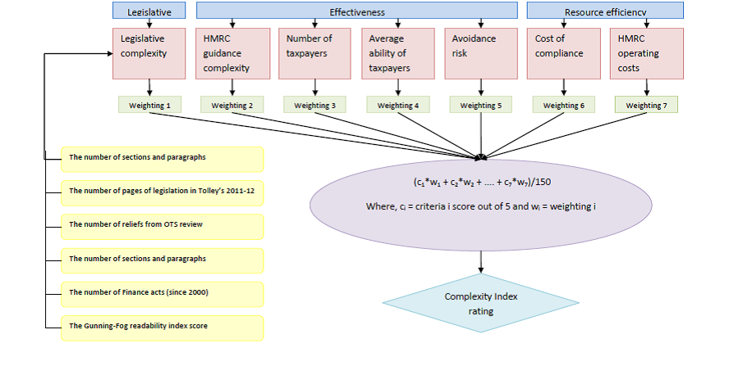

Slide 18
The latest index -in table- became more complex itself.
In the table, the UK tax system has been broken down into 111 areas, divided by different functions.
It has to be said that
the index is not be easy to understand
and
It does not allow the user and researchers to develop a comparative analysis
between different countries using this method.

Slide 19
D) Evans and Tran-Nam
Evans and Tran-Nam have made an important contribution of measuring tax complexity.
Their purpose of tax system complexity index is to show how the overall complexity of a particular tax system changes over time
Their approach was based on a combination of the test and statistical method in index number theory.
They have considered two indexes,
one devoted to business taxpayers
the other for personal taxpayers.
However, the designed index has not been tested yet by the authors so far.

Slide 20
E) Borrego, Loo, Lopes, and Ferreira
Borrego, Loo, Lopes, and Ferreira produced the General Tax Complexity Index in 2015.
This index combines three indexes, namely;
Index of Complexity of Preparation of Information and Record Keeping,
Index of Complexity of Tax Forms,
Legal Tax Complexity Index.
This study was mainly based on empirical data collected from a survey of tax professionals in Portugal.

Slide 21
According to the Index, Portuguese tax professionals perceived their tax system as having a high level of complexity (89.1%).
This result is in line with the international tax literature.
This reason was mostly related to legal concerns, that is,
volatility of tax laws (88.4%);
tax law too dispersed (86.1%);
preparation of accounting information for fiscal purposes (83.2%);
many exceptions to the rule and transitional arrangements (82.2%);
low perception and uncertainty of tax language (80.1%).

Slide 22
4. Results: we need an index for comparative analysis
Comparing levels of tax complexity in different countries is a difficult task as all countries have their own characteristics.
They may have different languages, traditions, cultures, legal systems and be at different stages of economic development.
Nonetheless, comparisons between different countries could be made if at least some common features and objective data in their tax legislation and systems.

Slide 23
The Complexity Indexes can be utilized to produce useful international comparisons but it would be even better if all indicators were clear and objective.
There is a vital requirement for an effective complexity index to be used in international comparisons between the countries under consideration.
These indexes may have been produced by the researchers.
Moreover, with the tangible experience of the OTS in this field, the new index may be considered as a milestone in terms of measuring tax complexity in different countries.
As a result, creating a simplification culture is at the heart of tax simplification process

Slide 24
Thank you for your attention
Tamer Budak & Serkan Benk

